Slide 1
Power Bi
Agenda
Introduction to Power Bi
Hands on with Power Bi Desktop
Start connect with Excel,CSV,Web
Connect with database
Connect with more than one table(joins and modeling)
Build Visuals
Deploy Solutions
System requirement
8 GB RAM
10 windows
Power BI Desktop Client
Office tools
SQL/Oracle

Slide 2
Power Bi
What is Power BI?
Power BI is a cloud-based Business Analysis and Intelligence service by Microsoft. It is a collection of business intelligence and data visualization tools such as software services, apps and data connectors
Microsoft offers three types of Power BI platforms:
Power BI Desktop (A desktop application)
Power BI Service (SaaS i.e., Software as a Service)
Power BI Mobile (For iOS and Android devices)

Slide 3
What is Power BI Desktop?
Power BI Desktop is a free application you install on your local computer that lets you connect to, transform, and visualize your data.
With Power BI Desktop, you can connect to multiple different sources of data, and combine them (often called modeling) into a data model.
This data model lets you build visuals, and collections of visuals you can share as reports, with other people inside your organization.
Most users who work on business intelligence projects use Power BI Desktop to create reports, and then use the Power BI service to share their reports with others.

Slide 4
Power BI Service (SaaS i.e., Software as a Service)
Power BI is a collection of software services, apps, and connectors that work together to help you create, share, and consume business insights in the way that serves you and your business most effectively.
The Microsoft Power BI service (app.powerbi.com), sometimes referred to as Power BI online, is the SaaS (Software as a Service) part of Power BI.
In the Power BI service, dashboards help you keep a finger on the pulse of your business. Dashboards display tiles, which you can select to open reports for exploring further.
Dashboards and reports connect to datasets that bring all of the relevant data together in one place.

Slide 5
Power BI Mobile
Power BI offers a set of mobile apps for iOS, Android, and Windows mobile devices. In the mobile apps, you connect to and interact with your cloud and on-premises data.

Slide 6
Why Power BI?
Why Power BI?
A quick start. You'll be able to get insights quickly with an uncomplicated setup, no required training, and included dashboards for services such as Salesforce, Google Analytics, and Microsoft Dynamics.
Streamlined publication and distribution. Instead of emailing large files or putting them on a shared drive, analysts upload reports and visualizations to the Power BI service, and their data is refreshed whenever the underlying dataset is updated.
Real-time information. Dashboards update in real time, as data is pushed or streamed in, which gives viewers the ability to solve problems and identify opportunities quickly.
Ability to customize Power BI app navigation. An "app navigation experiences" feature gives report developers the power to customize navigation to help viewers find content quickly and understand the relationships between different reports and dashboards.
Power BI can help connect multiple data sets like excel, csv, pdf, database

Slide 7
Benefits of Power BI
Data Analysis Power BI can collect your company data, whether it's located in the cloud or locally, and provides quick and easy access to this data. Your customers get a live 360 ° view of their business, enabling them to search and explore their data quickly and easily.
Interactive reporting Customers can see all data on only one screen and the Power BI Mobile apps are automatically updated with changes to your data so you can access updated data and reports no matter where you are or whenever you need it.
Financial overview In just a few seconds, Power BI gives you the full picture of your data across different data sources. Therefore, you can see all your financial data in a single view.
User-friendly mobility With the intuitive tools you can explore the underlying data, which makes it easy to find exactly the answers you need.
Data Visualization With Power BI you can be both creative and productive. Combine data from various databases, files and web services with the visual tools in Power BI and gain unique insight into your data

Slide 8
Power BI Features
Power BI Features
There are some of the most important and interesting features of Power BI:
Attractive Visualizations/ custom visualizations
GetData (Data sources)/data connections
Datasets
Dashboards
Filters
Reports
Trend indicators
Online Analytical Processing (OLAP)
Navigation pane
Natural language Q & A box
DAX functions and formula
Reports –Summarized information table. and Dashboard –Multiple tables Telling a story about

Slide 9
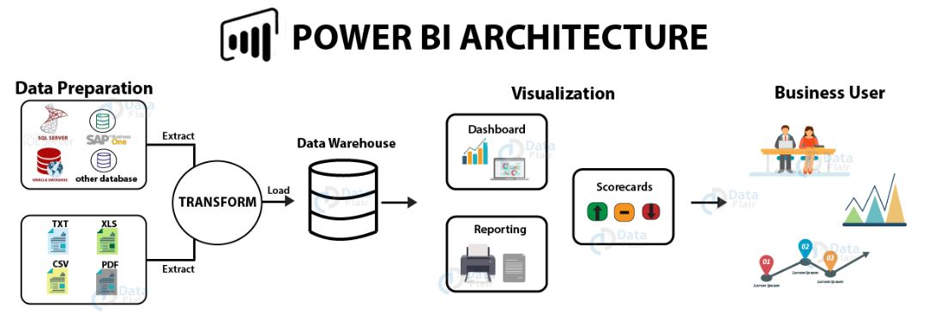
Power BI Architecture
Power BI Architecture

Slide 10
Power BI Architecture
1)Data Integration
In Power BI, we can import data from different kinds of data sources in different formats. In the data integration step, Power BI brings data together (extracted) from different data sources and converts it into a standard format. After data is integrated into Power BI, it is stored in a common storage area known as the staging area.
2. Data Processing
Once Power BI integrates and stores data at a secure place, the raw data requires some processing. Several processing or cleansing operations transform the raw data such as removing redundant values, etc. Later, we apply relevant business rules on the processed data that transforms it according to our business needs. This transformed data is loaded into the data warehouses. This completes a full process of ETL.
3. Data Presentation
In this final phase, the processed data moves from the warehouse and goes into the Power BI platforms like Power BI Desktop to create reports, dashboards, and scorecards. Power BI offers a wide range of visualizations. We can also import custom visualization from the marketplace. From the report development platforms, we can publish the reports on the web or mobile apps to share it with other business users.

